Slide 1
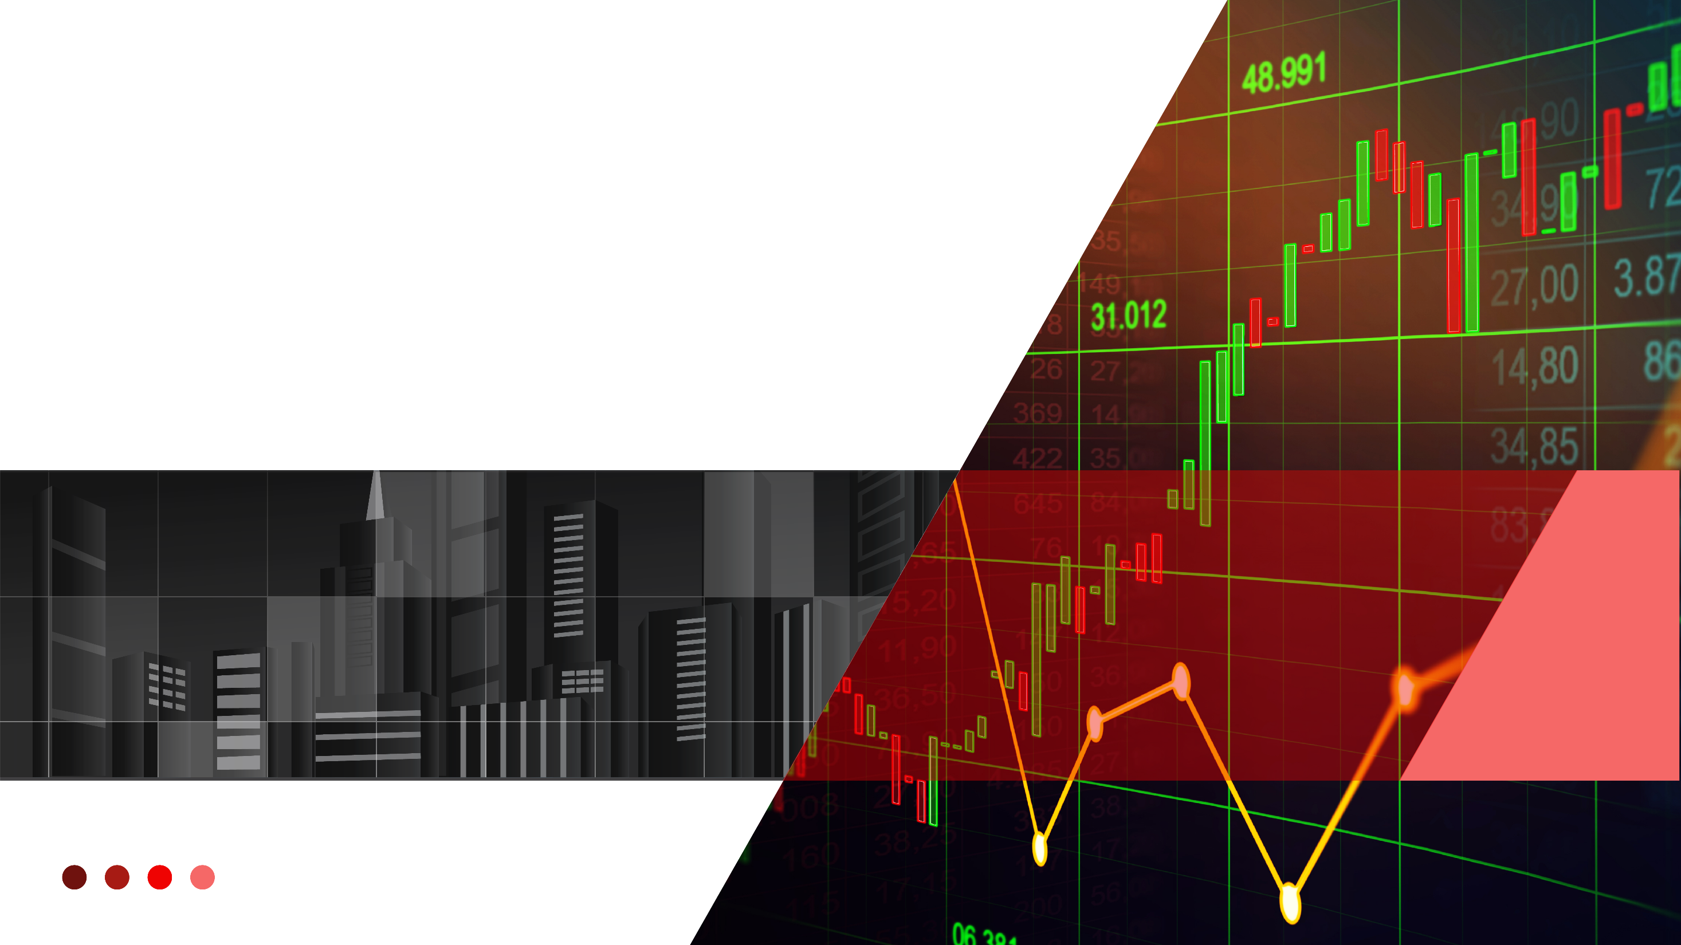
TESLA STOCK PRICE PREDICTIONS USING SUPERVISED LEARNING METHODS with Comparative analysis using ML Models
by
| JAHANGIR DEWAN | LAWSON JAMES | SOFIA MBEGA

Slide 2
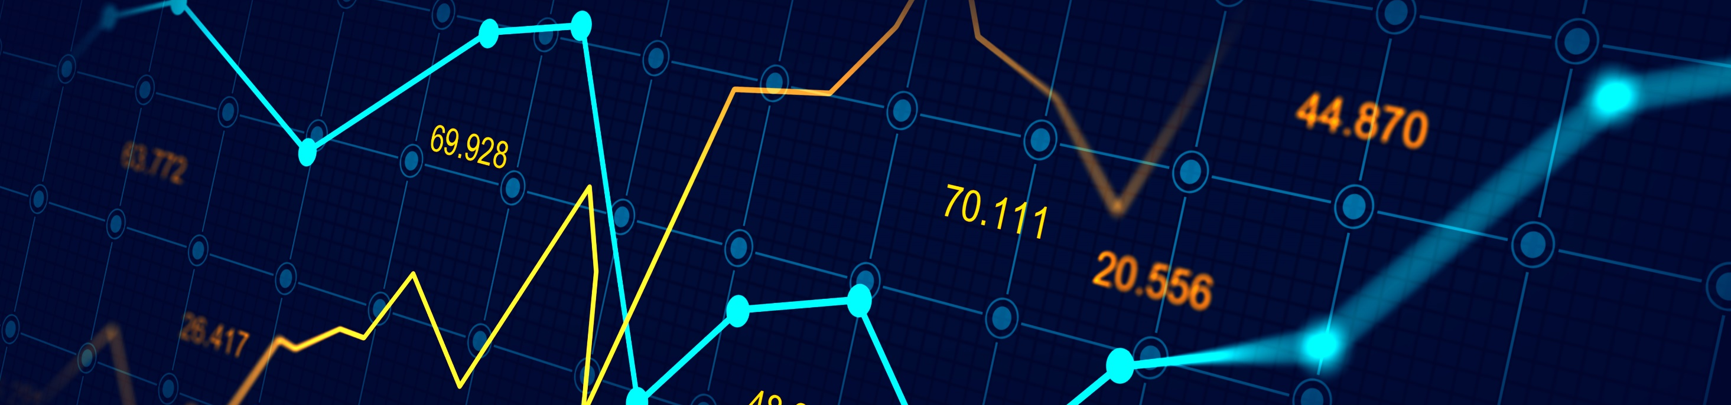
Executive Summary
In this project, we have Implemented Recurrent Neural Network (RNN) for Stock Market Prediction used for Portfolio Management considering Historical stock data for past 10 years from Yahoo Finance and Kaggle dataset
We have also compared the model with the traditional Machine Learning Algorithms such as Linear Regression, K-Nearest Neighbor (KNN) and Support Vector Machine (SVM) with Long Short-Term Memory (LSTM) Models.
Our analysis results (metrics) suggest that LSTM RNN Model performed better compared to other models

Slide 3
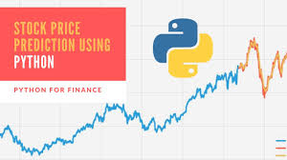
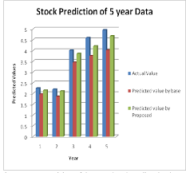
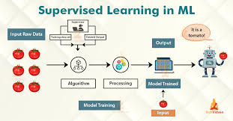
Overview and Purpose
Demonstrate predictability using a number of different Forecasting Techniques
Predict Future Stock values based on Past values
Forecasting: Applying Supervised learning methods for stock price Forecasting

Slide 4
Motivation
Provide near accurate prediction and data Visualization based on real data in a volatile Market Environment
To understand the limitations of using Machine Learning to in making predictions
To provide investors with insights in deciding when and in what stock to invest, to maximize profit

Slide 5

Challenges
Getting Latest Dataset from various sources
Learning curve on Various ML Models
Initially wanted to look on number of stock (TFAANNG) (TSLA, FB, APL, AMZN, NVDA, NFLX and GOOG). Decided to go with one and extend it further!
Too little time for analyzing multiple stocks and provide investment guidelines to diversify portfolio

Slide 6

Data Set
Pandas, datareader from web.Get_data_yahoo
Stock Price (CSV) : https://www.kaggle.com/
Platform: Jupyter Notebook

Slide 7

Goals
Explore stock prices for past 10 years Period from data sources
Implement basic model using linear regression
Implement LSTM using Keras library
Compare the results and submit the report

Slide 8

Structure of Data
Historical Daily Stock Market Data from Yahoo and Kaggle Datset (csv)
DATA PARAMETERS: Open, High, Low, Close, Volume, Adjusted Close

Slide 9
Data Processing
Performance Metrics/
Conclusion
Analysis
ML Modeling
Visualizations

Slide 10
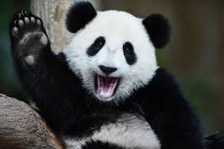
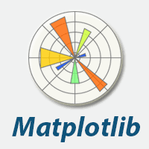
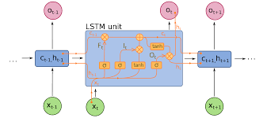
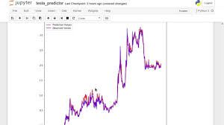

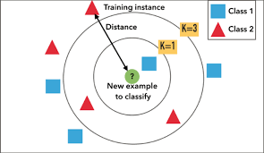
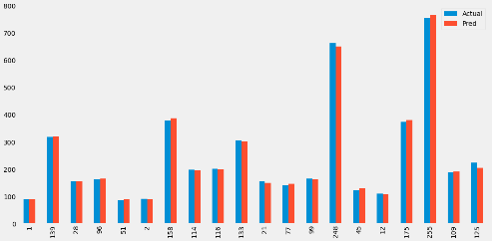


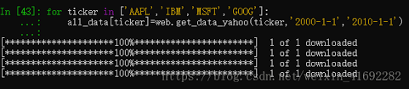

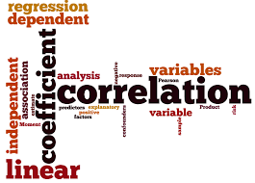
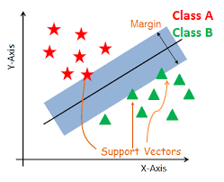
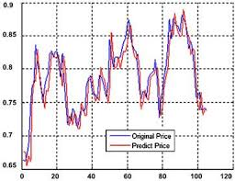
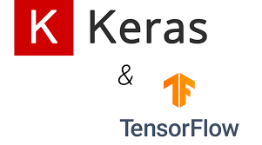

Top level system architecture
PROCESSING
ML Modeling and Analysis
Visualization
LSTM
DATABASE
LRKNN
web.get_data_yahoo
LR
SVM

Slide 11
Models used
1.
RNN - Neural Networks
3.
K-Nearest Neighbor (KNN)
5.
LSTM
2.
Linear Regression
4.
Support Vector Machine (SVM)

Slide 12
Work flow - Algorithm
Recurrent Neutral Network
90% of Data
Build Model
(LSTM RNN using keras
Calculating and verifying metrics
Data Preprocessing
YAHOO FINANCE
DATA
Windows
Validation
Using pandas-datareader
Testing the trained model
Normalisation
Output (Test)
Output (Prediction)
Data Split
Testing
Prediction
10% of Data
Plot (Using Matplotlib)
Plot (Using Matplotlib)
Using a new data from Yahoo finance normalizing it

Slide 13
DATA VISUALIZATION PLOTS & METRICS

Slide 14
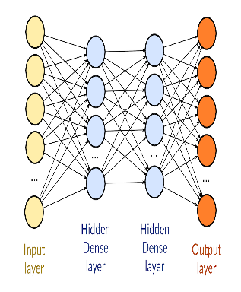
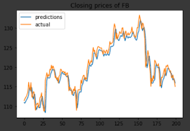
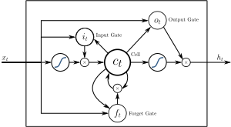
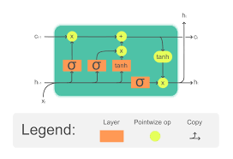


CREATE MACHINE LEARNING MODEL FOR PREDICTION
DATASET
BUILD MODEL
TRAIN MODEL
PREDICTION
COMPILE MODEL
TESTING

Slide 15
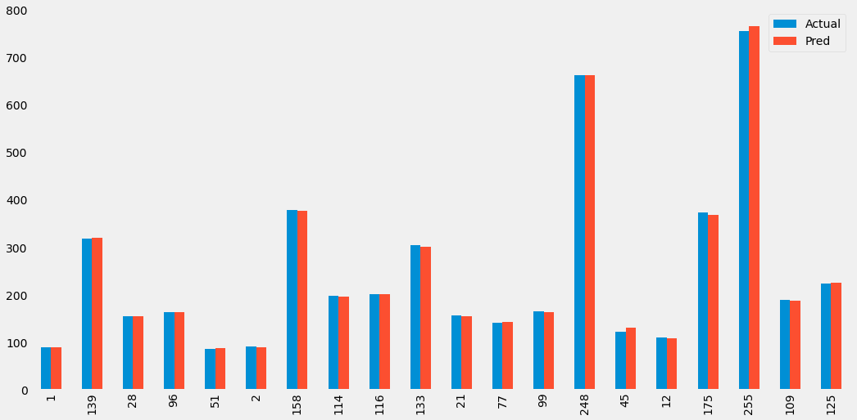
Data visualization: Linear Regression Model
RMSE: 4.1048

Slide 16
Data visualization: KNN (K Nearest Neighbor) Model
RMSE: 8.4823

Slide 17

Data visualization: SVM (SUPPORT VECTOR MACHINE)
RMSE: 4.3509

Slide 18
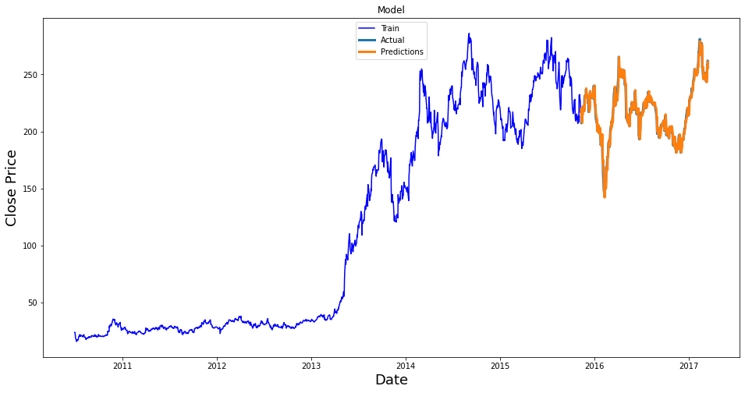
Data visualization: LSTM (LONG SHORT-TERM MEMORY CELLS)
RMSE: 0.0997

Slide 19
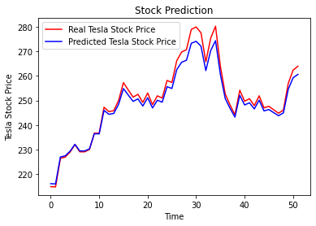
REAL STOCK PRICE vs PREDICTED PRICE
THE PREDICTED PRICE OF TSLA
TSLA STOCK IS VERY CLOSE TO
THE REAL PRICE

Slide 20

Comparison results of ML models
LINEAR RMSE: RMSE: 4.1048
KNN RMSE : 8.4823
SVM RMSE : 4.3509
LSTM RMSE : 0.0997

Slide 21
WEB APPS - VISUALIZATION
https://jjjdewan.github.io/Final-project/index.html

Slide 22

Conclusion
Performance metrics: Root Mean Square Error and R2 (r-squared error) metrics suggests that LSTM Prediction is more accurate compared to other models
Future works: Analyze and Predict Multiple Stocks (i.e. TFAANNG) and provides Investors Realtime feedback on which stocks to invest on better RoI

Slide 23
THANK YOU!
QUESTION AND ANSWERS
?

